Slide 1
Title
Authors and Affiliation

Slide 2
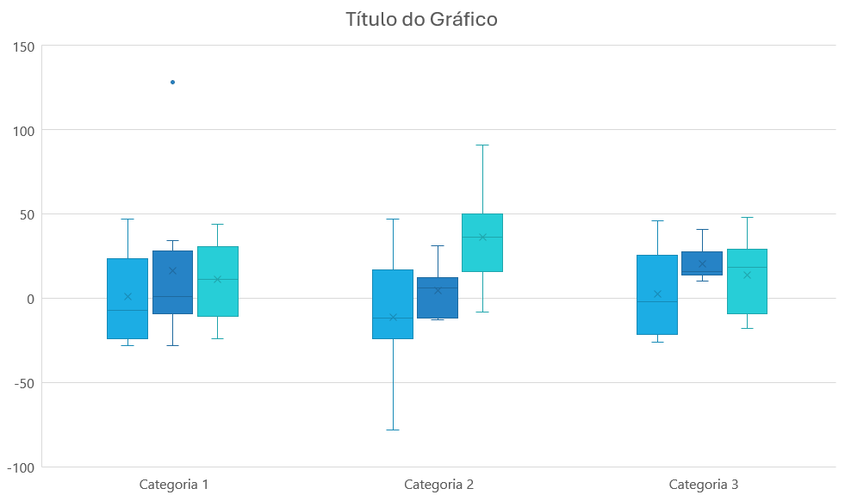
Example Template - Title
Authors and Affiliation
+
Introduction
Methodology
It should provide a concise overview of the research context and background, clearly stating the problem or question being addressed. It should outline the significance of the study and its relevance to the field, offering just enough detail to engage the audience without overwhelming them.
Key objectives or hypotheses should be highlighted, setting the stage for the methods, results, and conclusions that follow.
It should succinctly describe the approach and techniques used to conduct the research. It should include details about the study design, data collection methods, and analysis techniques, ensuring clarity and reproducibility.
Focus on the most critical aspects of the methodology, using visuals like flowcharts or diagrams if they enhance understanding (only if needed).
Avoid excessive technical jargon and keep the explanation concise to maintain the audience's attention.
Results
It should present the key findings of your research clearly and concisely.
Use visual elements like graphs, charts, tables, or images to effectively convey data and trends.
Highlight the most important outcomes, ensuring they align with your research objectives.
Avoid overloading the section with text; instead, let the visuals tell the story, supplemented by brief, descriptive captions or bullet points. Ensure that all figures are labelled and easy to interpret for your audience.
Conclusions
Acknowledgements
It should succinctly summarize the main takeaways from your research. Highlight how your findings address the research question or objectives outlined in the introduction.
Discuss the implications of your results and their relevance to the broader field. If applicable, suggest practical applications or next steps for further research. Keep the text concise and focused, using bullet points or short paragraphs to ensure clarity. Avoid introducing new data or concepts in this section.
It should briefly recognize individuals, organizations, or institutions that contributed to the success of your research.
This may include funding agencies, collaborators, advisors, or colleagues who provided significant support, resources, or expertise. Mention any grants, fellowships, or institutional backing that facilitated the work.
Keep the section concise and professional, typically formatted as a short paragraph or a bulleted list.

